Slide 1


UTDF2GMNS: An Open-Source Tool for Creating GMNS Networks with Signalized Intersections
Xiangyong Roy Luo
Yunus Emre Avci
Patrick Jiang

Slide 2
Content
GMNS
UTDF
UTDF2GMNS

Slide 3
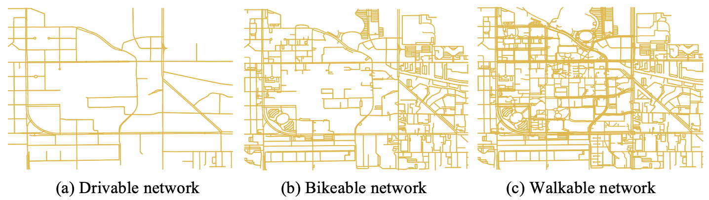
General Modeling Network Specification (GMNS)
GMNS: provide a common human and machine-readable format
for sharing routable road network files
github.com/zephyr-data-specs/GMNS
OpenStreetMap -> osm2gmns -> GMNS -> Network Modeling and Simulation
3
Notes:
FHWA + USDOT + Research Institutes + NSF supported project

Slide 4
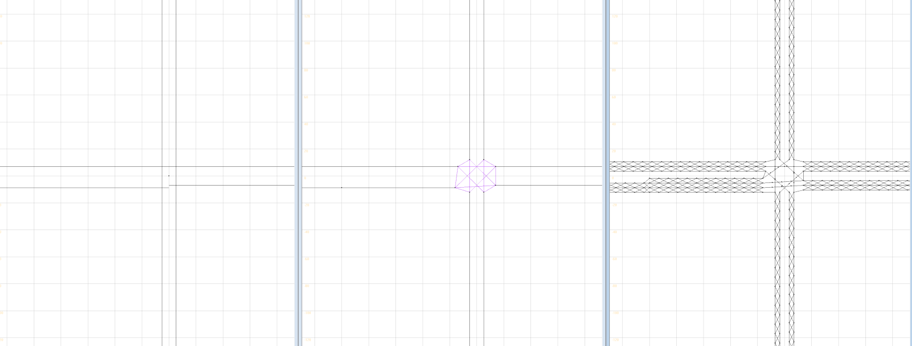




General Modeling Network Specification (GMNS)
GMNS: provide a common human and machine-readable format
for sharing routable road network files
github.com/zephyr-data-specs/GMNS
Missing Intersection Connection
Left-turn bay
Bridge the gap!
Macroscopic Net:
One intersection is represented by one node
Mesoscopic Net:
Intersections are expanded
Movement links are built
Microscopic Net:
Cell-based network
Detailed segment information
GMNS + Signalized Intersections
Macroscopic Net
Mesoscopic Net
Microscopic Net
4
Notes:
FHWA + USDOT + Research Institutes (Universities) + NSF supported project

Slide 5
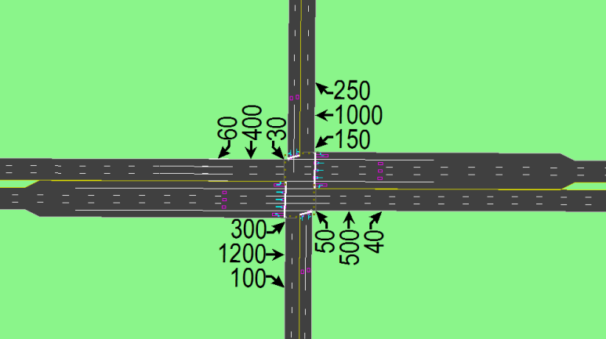

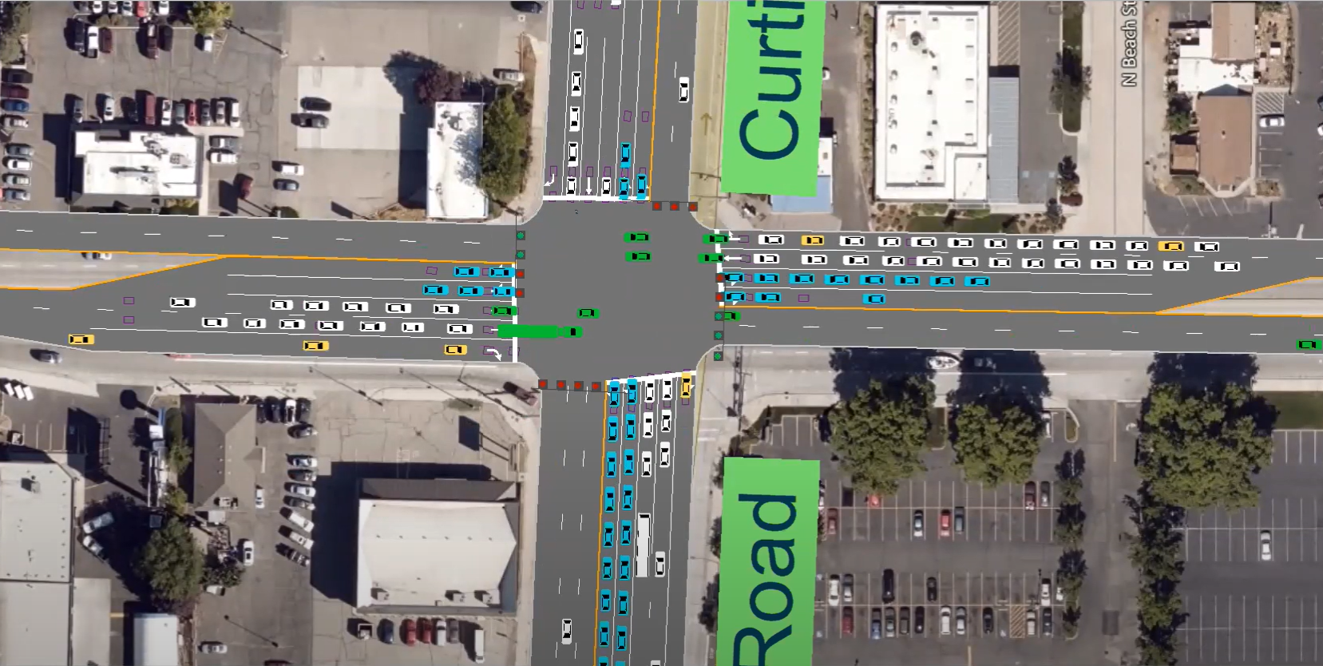
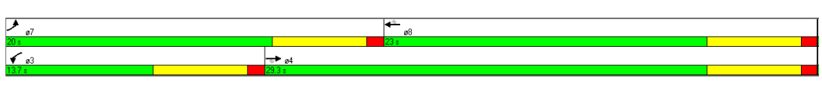
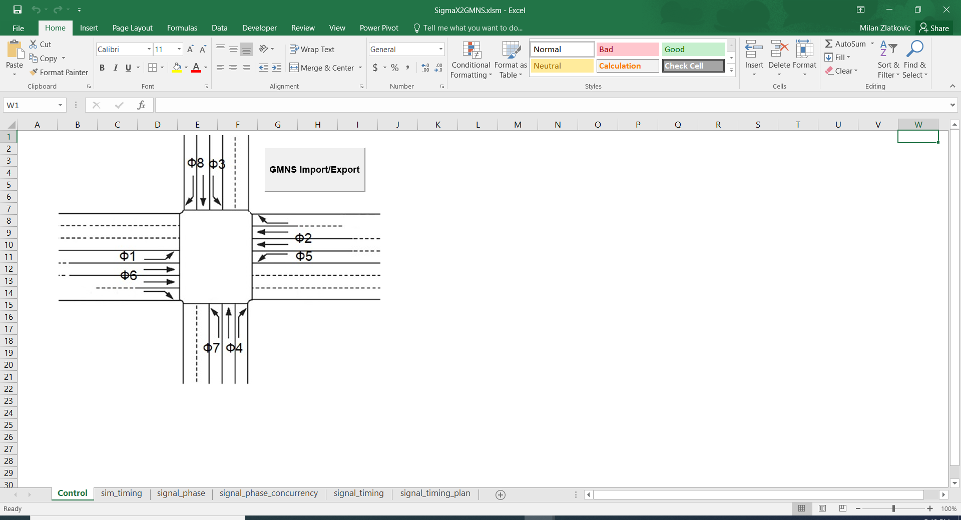
Universal Traffic Data Format (UTDF)
Universal Traffic Data Format (UTDF) file that contains traffic signal and traffic related data for intersections
Geometry of the network
Turn volumes
Signal timings
Turning
Volume
Signalized Intersections
Time
Phasing
UTDF Standard
Node
Link
Lane

Slide 6
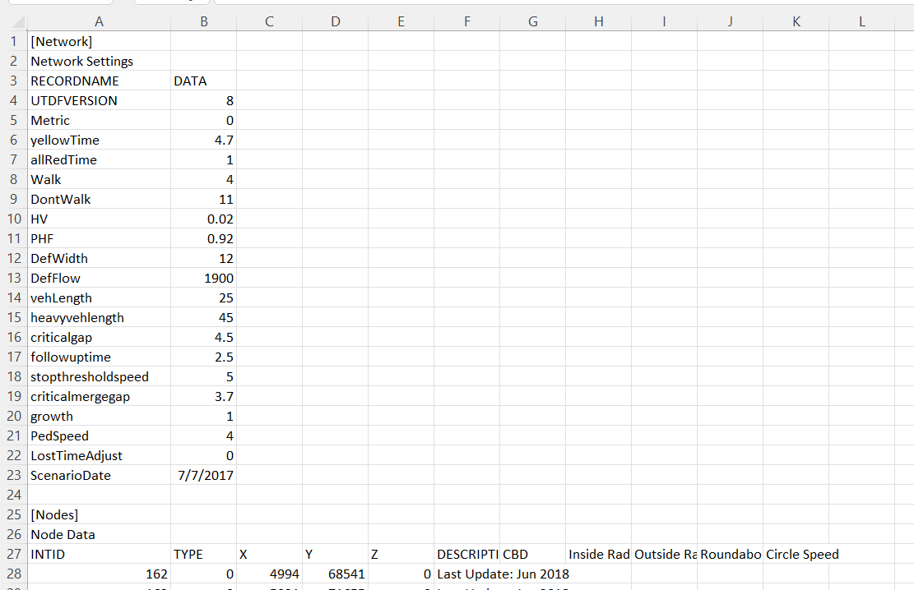
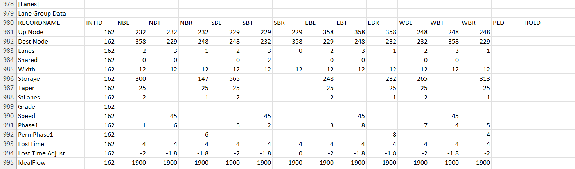
Universal Traffic Data Format (UTDF)
UTDF Format
Notes:
We are good at file format!

Slide 7
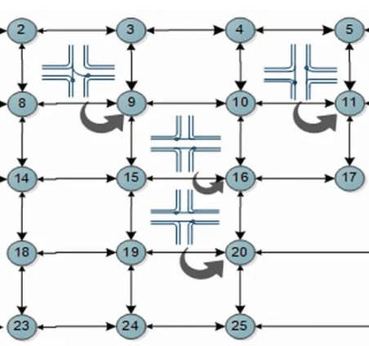
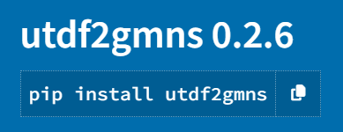
UTDF2GMNS: An open-source tool to generate network with signalized intersection
UTDF Standard
Signalized Network

Slide 8
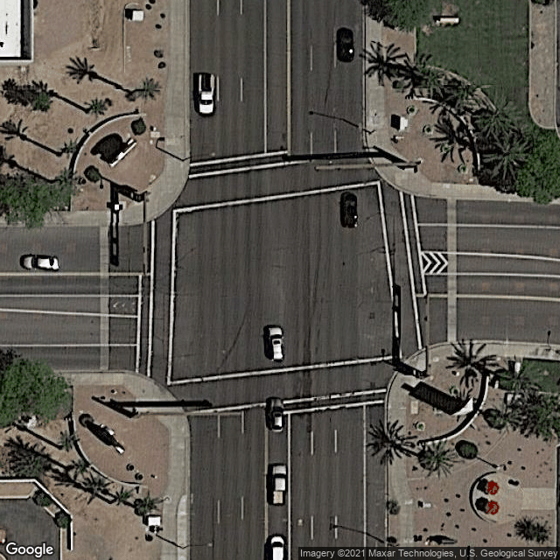
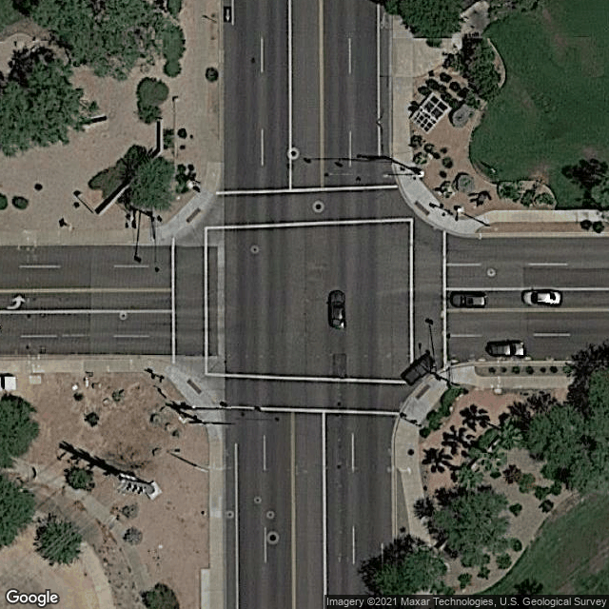
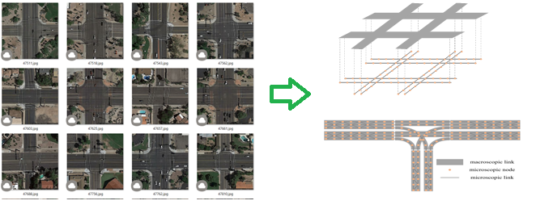
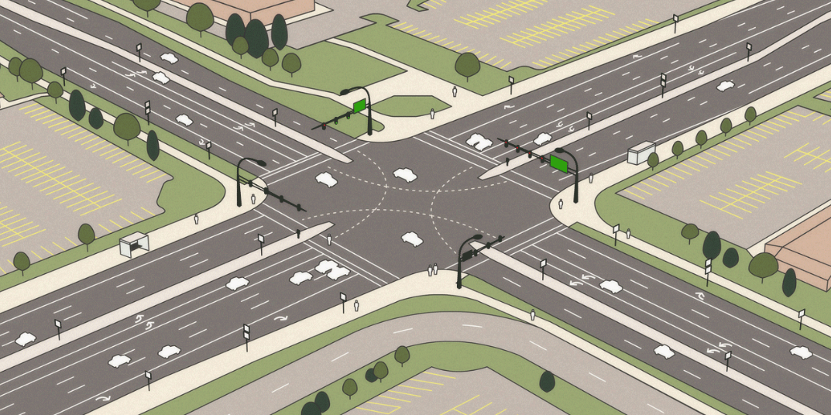
One More Thing
UTDF2GMNS:
Geometry: Intersection, Node, Link, Lane
Signal Phases
Turning volumes
# of lanes
Through, Right, Left, U-turn
Img2Net
Notes:
AI to process images and identify which network with different movement and lane configurations: detailed intersection and network configurations.

Slide 9
Takeaway Message:
1.
OpenStreetMap -> osm2gmns -> GMNS (Node, Link, Network, Movement) -> Modeling , Simulation
2.
Synchro UTDF -> UTDF2GMNS -> GMNS (Turning Volumes, Signal Timing, Intersection Geometry)
Combine 1 and 2, Marco-Meso-Micro level of Networks + Signalized Intersections
3.
Intersection Images -> Img2Net -> GMNS (Lane, Turning, Geometry)

